Slide 1
Gene optimization: Cell and Tissue level

Slide 2
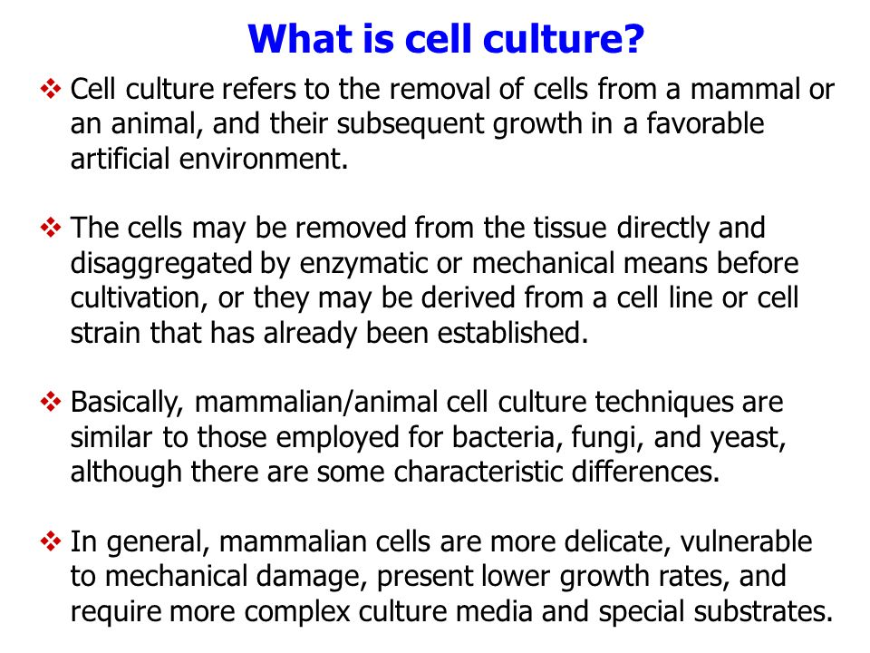

Slide 3
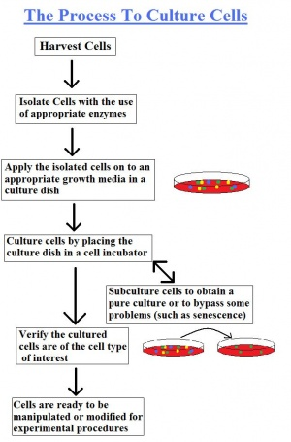

Slide 4
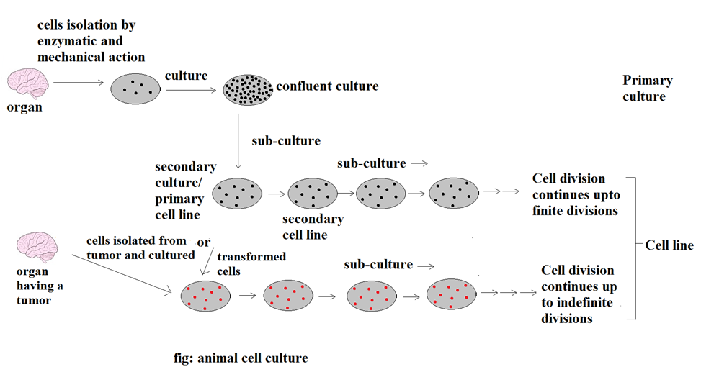
Animal cell culture- detailed process

Slide 5
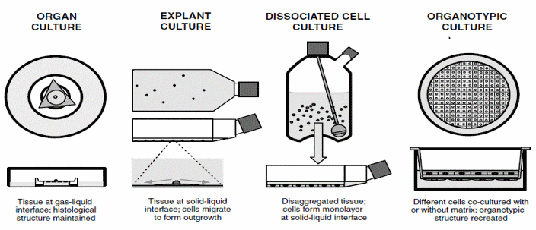
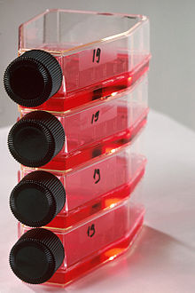
Animal cell culture- Types

Slide 6
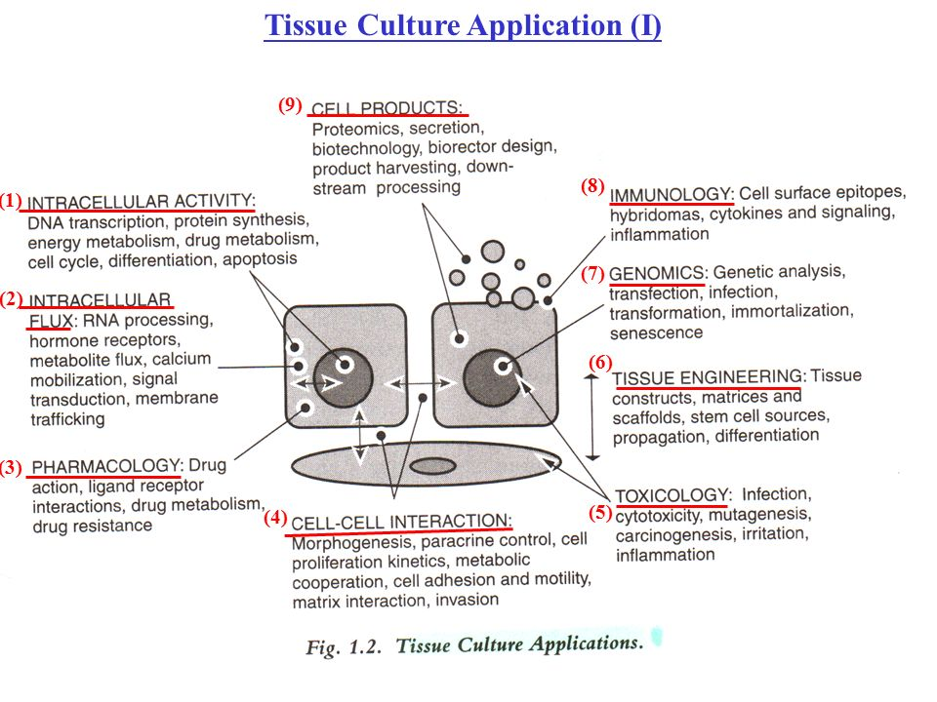
Animal cell culture- Applications

Slide 7
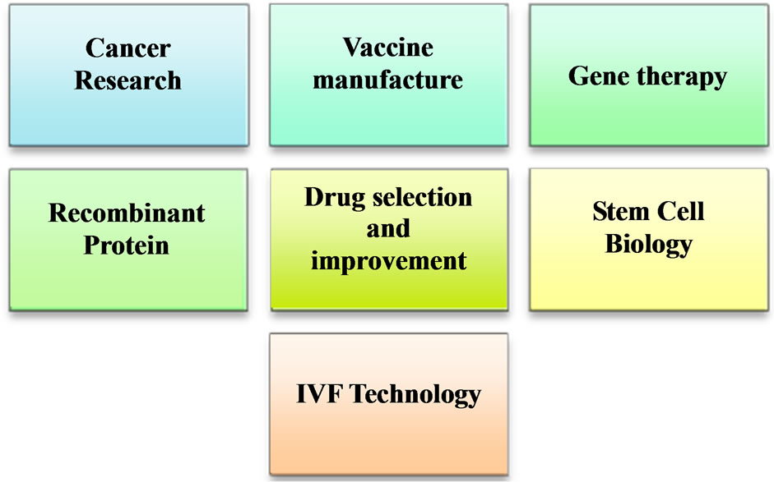

Slide 8
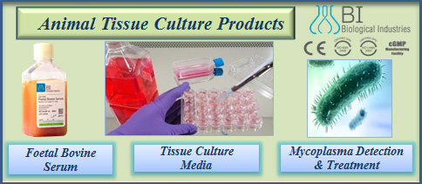

Slide 9
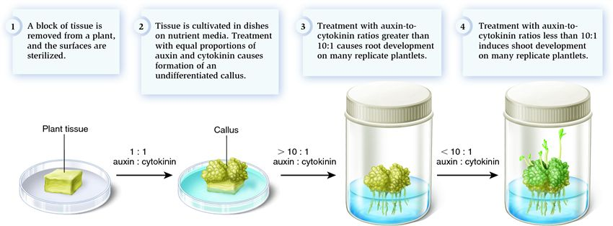
Plant cell culture- process

Slide 10
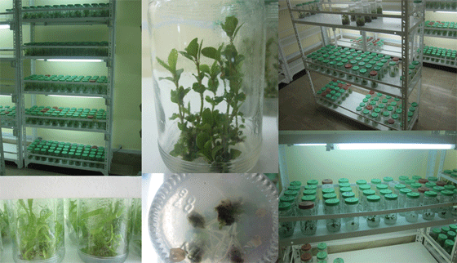
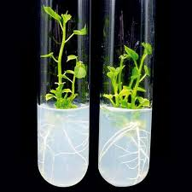
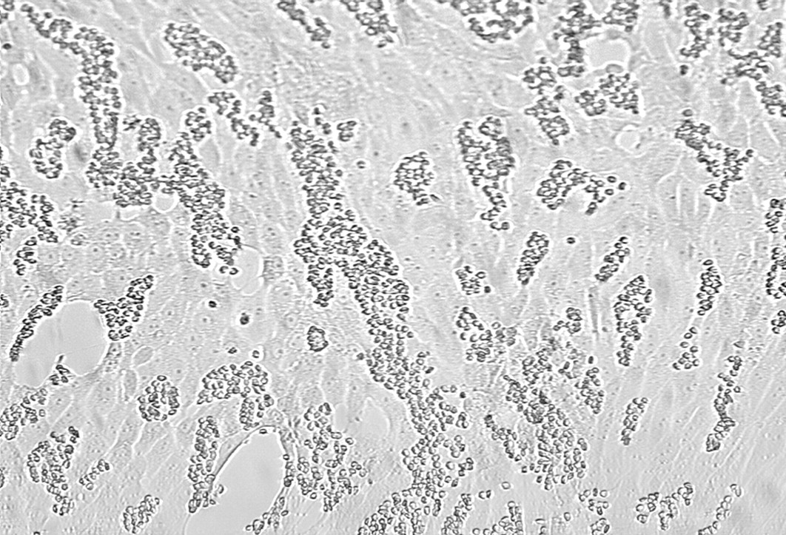

Slide 11
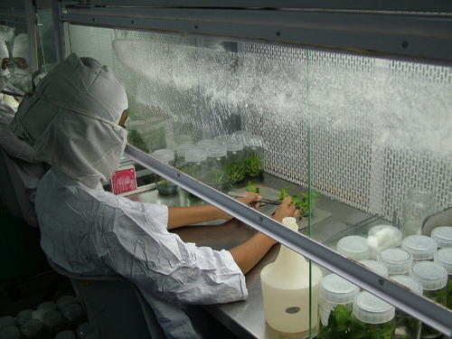

Slide 12
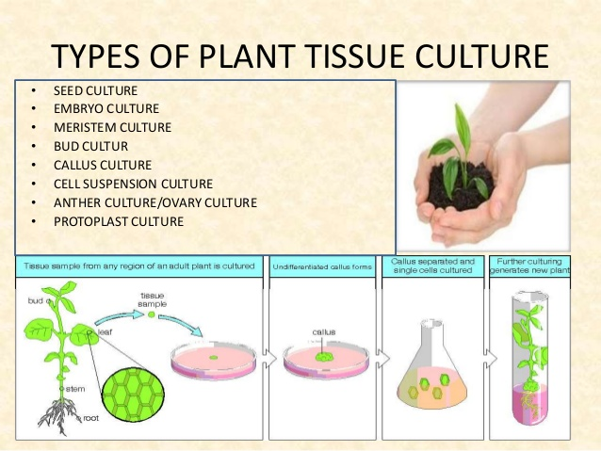

Slide 13
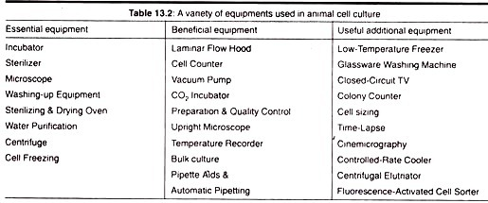

Slide 14
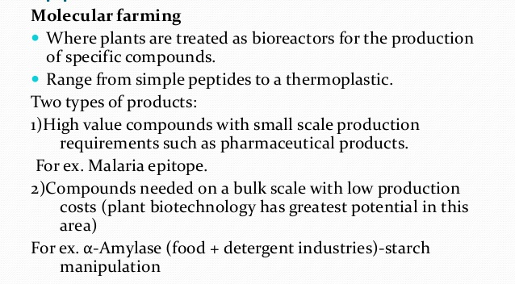
Plant and Animal cell culture- Applications

Slide 15
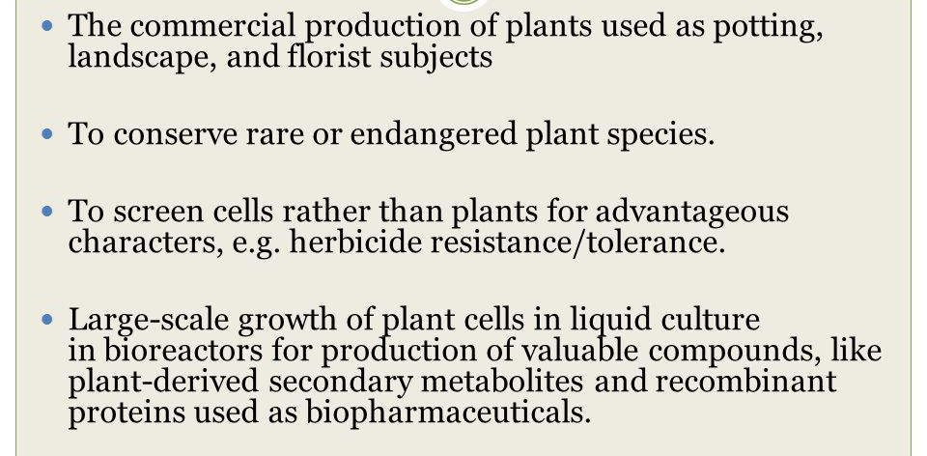
Plant and Animal cell culture- Applications

Slide 16
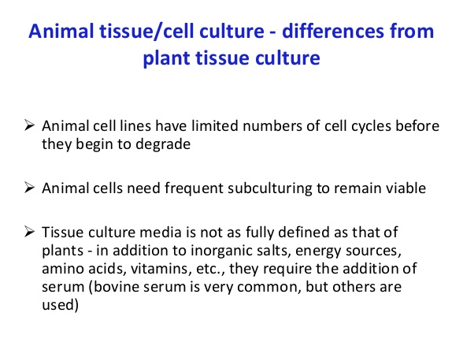

Slide 17
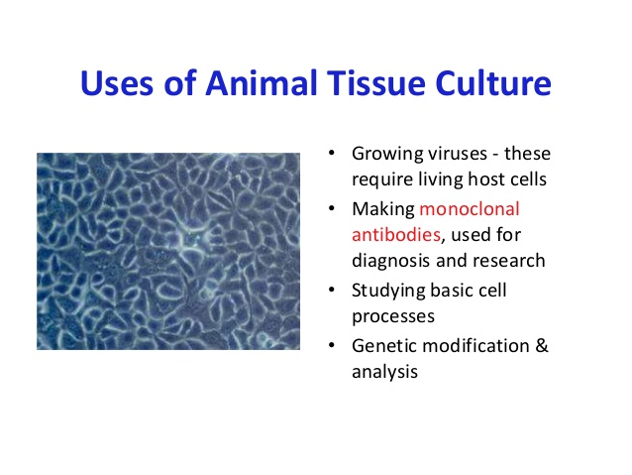
Hybridoma Technique

Slide 18
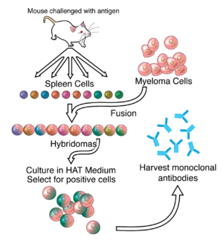
Hybridoma Technique- procedure

Slide 19
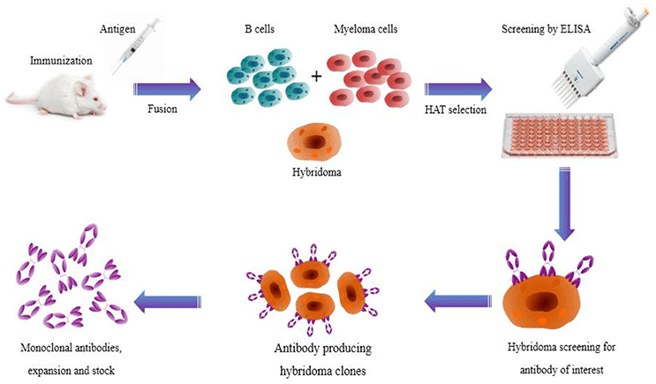
Hybridoma Technique- detailed procedure

Slide 20
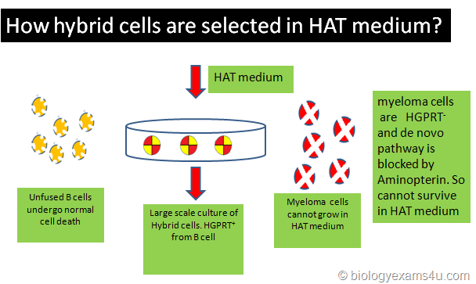
HAT medium – Hypoxanthine – Aminopterin – Thymidine medium

Slide 21
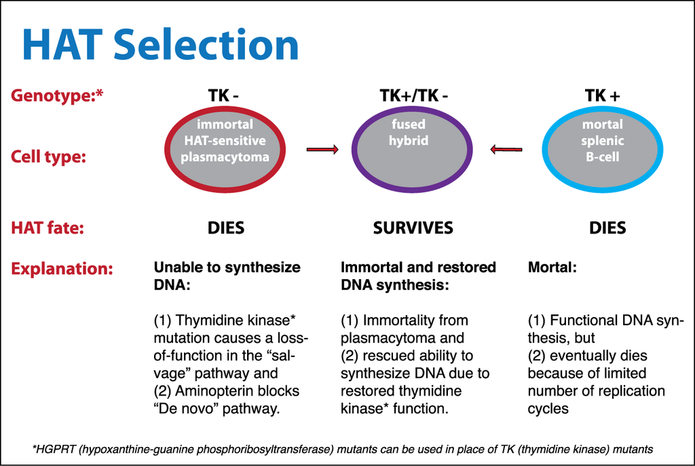
Hybridoma Technique

Slide 22
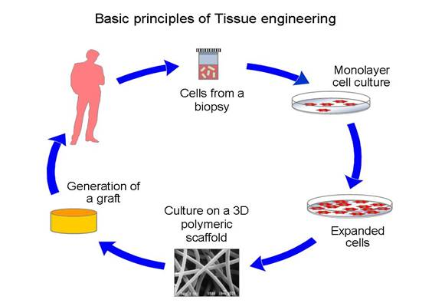
Tissue Engineering

Slide 23
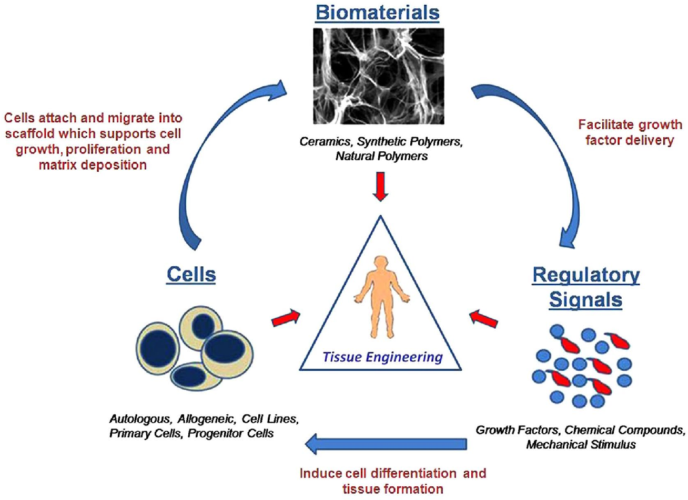

Slide 24
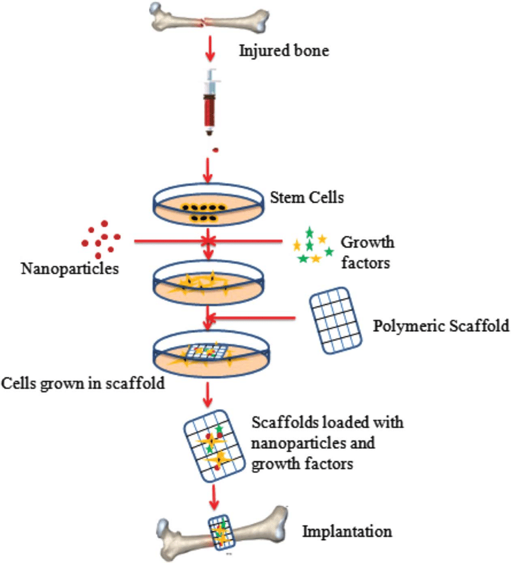

Slide 25
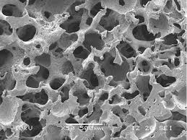
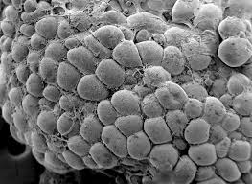
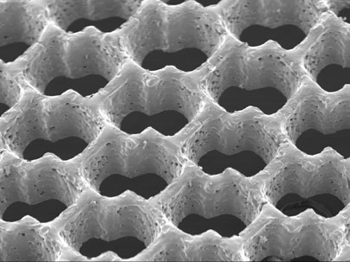
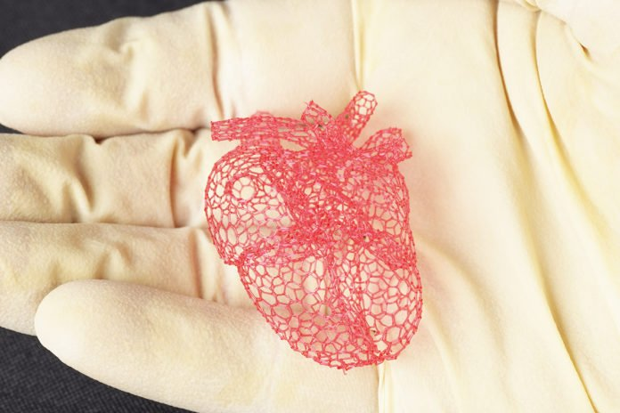
Types of Scaffolds

Slide 26
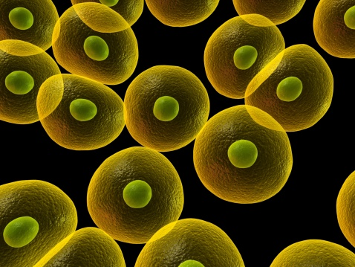

Slide 27
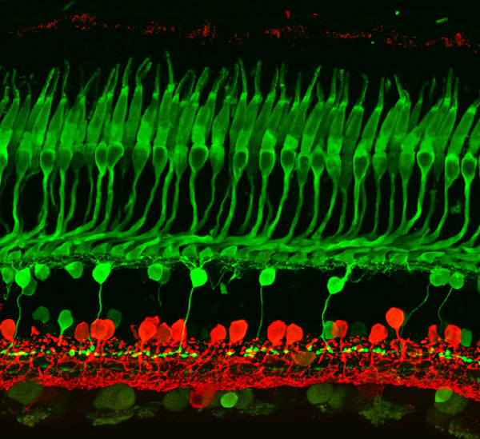

Slide 28
Tissue engineering
Tissue engineering is the use of a combination of cells, engineering and materials methods, and suitable biochemical and physio-chemical factors to improve or replace biological functions.
Stem cells are cells found in most, if not all, multi- cellular organism. They are characterized by the ability to renew themselves through mitotic cell division and differentiating into a diverse range of specialized cell types.
The two broad types of mammalian stem cells are:
embryonic stem cells
adult stem cells

Slide 29
Components
Cells
Extra cellular matrix or scafold
Biological active molecules

Slide 30
Examples in tissue engineering …
Bioartificial liver device — several research efforts have produced hepatic assist devices utilizing living hepatocytes.
Artificial pancreas — research involves using islet cells to produce and regulate insulin, particularly in cases of diabetes.
Artificial bladders — Anthony Atala (Wake Forest University) has successfully implanted artificially grown bladders into seven out of approximately 20 human test subjects as part of a long-term experiment.
Cartilage — lab-grown cartilage tissue used to repair knee
Doris Taylor's heart in a jar
Artificial skin from human skin cells embedded in collagen
Artificial bone marrow

Slide 31
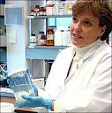
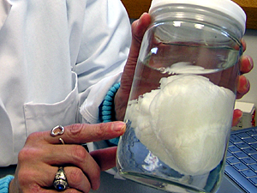
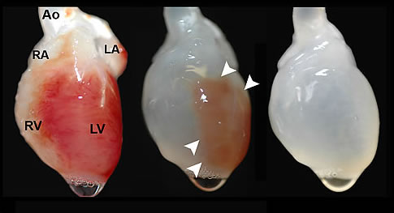

Slide 32
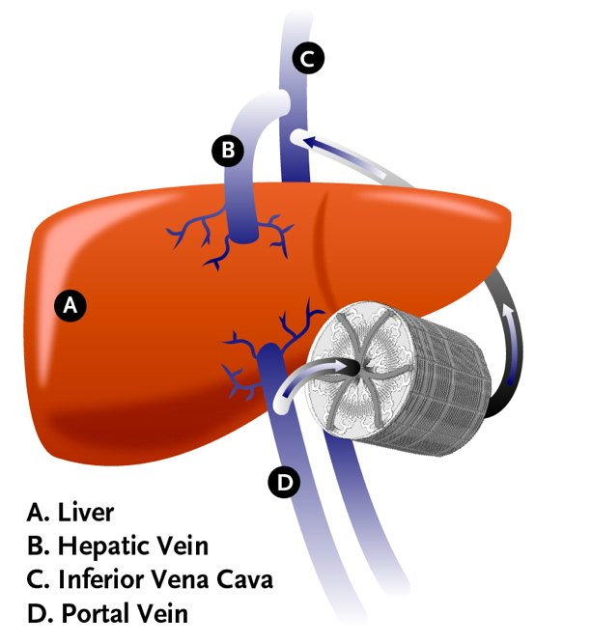
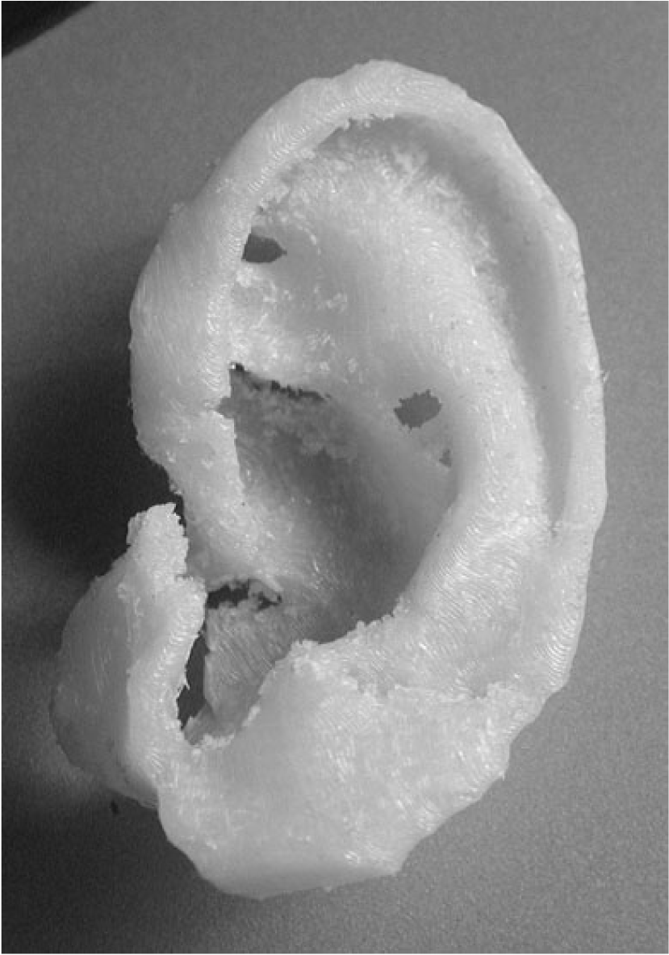

Slide 33
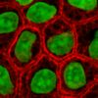
Cells as building blocks:
Living fibroblasts – skin or chondrocytes – cartilage
Cell division – extension of telomerase activity (1998)
Heyflick limit
Extraction of cells:
Bulk extraction (centrifugation)
Digestion (enzyatic to remove the scafold)
Extraction of free floating cells
Collagenase : preferred reagent
less temperature dependent, and damages fewer cells, but
takes longer and is a more expensive reagent

Slide 34
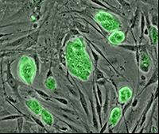
Categories of cells: based on the source
Autogenic
Allogenic
Xenogenic
Syngenic

Slide 35
Extracellular matrix or scafold …
Allow cell attachment and migration
Deliver and retain cells and biochemical factors
Enable diffusion of vital cell nutrients and expressed products
Exert certain mechanical and biological influences to modify the behaviour of the cell phase
Carbon nanotube
candidate for tissue engineering scaffolds
biocompatible
resistant to biodegradation
Can be functionalized with biomolecules.
However, the possibility of toxicity with non-biodegradable nano-materials is not fully understood.

Slide 36
Properties of material …
High porosity and an adequate pore size
Biodegradability or desired resorption rate
Non immunogenecity
Low concentration
Structural integrity @ nanolevel
Injectability

Slide 37
Source of material for scafold …
Natural or constructed from natural materials
derivatives of the extracellular matrix – proteic material such as collagen or fibrin
polysaccharidic material:chitosan or glycosaminoglycans (GAG) with cross linking agents (e.g. glutaraldehyde, water soluble carbodiimide),
bioresorbable sutures like collagen
Synthetic –
PuraMatrix, PLA - polylactic acid (polyester) Degrades within the human body to form lactic acid,
Polyglycolic acid (PGA) and polycaprolactone (PCL): their degradation mechanism is similar to that of PLA, but slightly slower.

Slide 38
Extracellular matrix or scafold …
Allow cell attachment and migration
Deliver and retain cells and biochemical factors
Enable diffusion of vital cell nutrients and expressed products
Exert certain mechanical and biological influences to modify the behaviour of the cell phase
Carbon nanotube
candidate for tissue engineering scaffolds
biocompatible
resistant to biodegradation
Can be functionalized with biomolecules.
However, the possibility of toxicity with non-biodegradable nano-materials is not fully understood.

Slide 39
Properties of material …
High porosity and an adequate pore size
Biodegradability or desired resorption rate
Non immunogenecity
Low concentration
Structural integrity @ nanolevel
Injectability

Slide 40
Source of material for scafold …
Natural or constructed from natural materials
derivatives of the extracellular matrix – proteic material such as collagen or fibrin
polysaccharidic material:chitosan or glycosaminoglycans (GAG) with cross linking agents (e.g. glutaraldehyde, water soluble carbodiimide),
bioresorbable sutures like collagen
Synthetic –
PuraMatrix, PLA - polylactic acid (polyester) Degrades within the human body to form lactic acid,
Polyglycolic acid (PGA) and polycaprolactone (PCL): their degradation mechanism is similar to that of PLA, but slightly slower.

Slide 41
Methods for synthesis of a scafold …
1) Molecular Self-Assembly:
Biomaterials with properties similar in scale and chemistry
the natural in vivo extracellular matrix (ECM).
polymers + hydrogel -- assemble on their own as hydrogel scaffold Merit : superior in vivo toxicology and biocompatibility.
2) Textile technologies:
Preparation of non-woven meshes of different polymers. e.g. non-woven polyglycolide structures.
Grow different types of cells.
Drawback - difficulties of obtaining high porosity and regular pore size.

Slide 42
3) Solvent Casting & Particulate Leaching (SCPL):
1. the polymer is dissolved into a suitable organic solvent
(e.g. polylactic acid could be dissolved into dichloromethane),
2. the solution is cast into a mold filled with porogen particles of inorganic salt like sodium chloride, crystals of saccharose, gelatin spheres or paraffin spheres. The size of the porogen particles and the polymer to porogen ratio is directly correlated to the amount of porosity of the final structure.
3. The solvent is allowed to fully evaporate,
4.the composite structure in the mold is immersed in a bath of a liquid suitable for dissolving the porogen. Once the porogen has been fully dissolved a porous structure is obtained.
Merit: Regular porosity
Drawback - organic solvents may cause damage to the cells seeded on the scaffold.

Slide 43
4) Gas Foaming:
1.Disc shaped structures made of the desired polymer are prepared by means of compression molding using a heated mold.
2.The discs are then placed in a chamber where are exposed to high pressure CO2 for several days.
3.The pressure inside the chamber is gradually restored to atmospheric levels. During this procedure the pores are formed by the carbon dioxide molecules that abandon the polymer, resulting in a sponge like structure.
Merit: No use of solvents
The drawbacks: prohibits use of temperature labile material
& pores do not form an interconnected structure.

Slide 44
5) Emulsification/Freeze-drying:.
1. a synthetic polymer is dissolved into a suitable solvent (e.g. polylactic acid in dichloromethane),
2. water is added to the polymeric solution
3. the two liquids are mixed in order to obtain an emulsion.
4. the emulsion is cast into a mold
5. quickly frozen by means of immersion into liquid nitrogen.
6. The frozen emulsion is subsequently freeze-dried to remove the dispersed water and the solvent, thus leaving a solidified, porous polymeric structure.
Merit: does not require the use of a solid porogen like SCPL Drawbacks -it still requires the use of solvents, pore size is relatively small and porosity is often irregular)

Slide 45
6) Thermally Induced Phase Separation (TIPS):
Similar to the emulsifier technique, (this phase separation procedure requires the use of a solvent with a low melting point that is easy to sublime. For example dioxane could be used to dissolve polylactic acid, then phase separation is induced through the addition of a small quantity of water: a polymer-rich and a polymer-poor phase are formed. Following cooling below the solvent melting point and some days of vacuum-drying to sublime the solvent a porous scaffold is obtained.) Liquid-liquid phase separation presents the same drawbacks of emulsification/freeze-drying.

Slide 46
CAD/CAM Technologies:
since most of the above described approaches are limited when it comes to the control of porosity and pore size, computer assisted design and manufacturing techniques have been introduced to tissue engineering. First a three-dimensional structure is designed using CAD software, then the scaffold is realized by using ink-jet printing of polymer powders or through Fused Deposition Modeling of a polymer melt.

